Slide 1

Introducing Economics for Quant Finance
Rony.Z

Slide 2

Econ & Econ for Quant Finance
General Economics
Broader
A study
Resource Allocation
Can be related to many other fields
Econ for Quant Finance
Implementation
Model & Predict
Economic Indicators

Slide 3
Open Discussion: What economics indicators do you know?
Indicators? What are they????

Slide 4
Interest Rate Inflation Rate Unemployment Consumption Gov Policy GDP Growth
There’s tons of them…

Slide 5
But! Are they equally important?
YES!!!!!
NO!!!!!
MAYBE??? (How should I know)

Slide 6


Slide 7
Why do you think this is influential?
Okay…

Slide 8
Discussion time!
There is a note on your table
On the note, there is one indicator

Slide 9
Questions
What is this indicator measuring?
How does it impact the economy and financial markets?
Can you think of an example where this indicator had a major impact on a specific stock or sector? (Can search online)

Slide 10
UK Job(Labor) Market
How might rising unemployment affect a sector-heavy portfolio in the UK market?
If wage inflation increases, how might you adjust a quant model’s sector exposure to hedge against inflation risks?

Slide 11
Job Market Data
Unemployment Rates
Wage Inflation
Sector-Specific Employment Data
Labor Force Participation Rate
Etc.

Slide 12
Labor market data is:
A key indicator to refer to
Especially in Quant Models
Strategies account for macroeconomic conditions
Usually connect with:
Consumer Spending Power
Company Performance

Slide 13
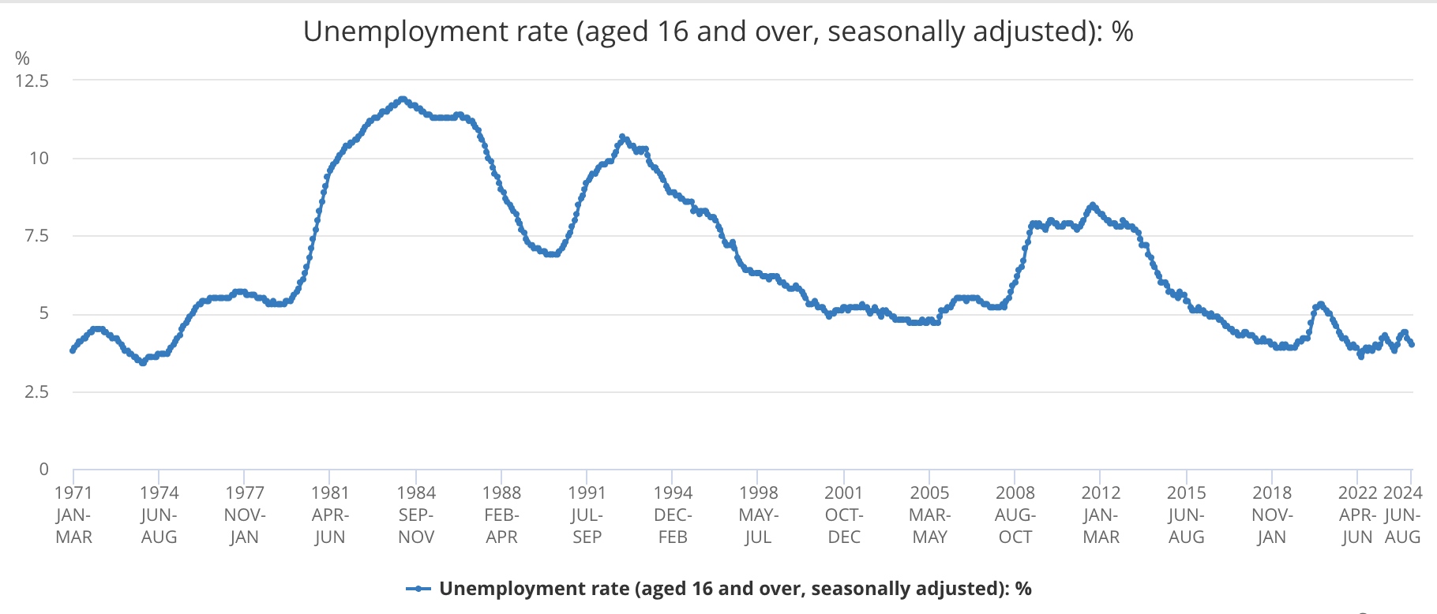

Slide 14
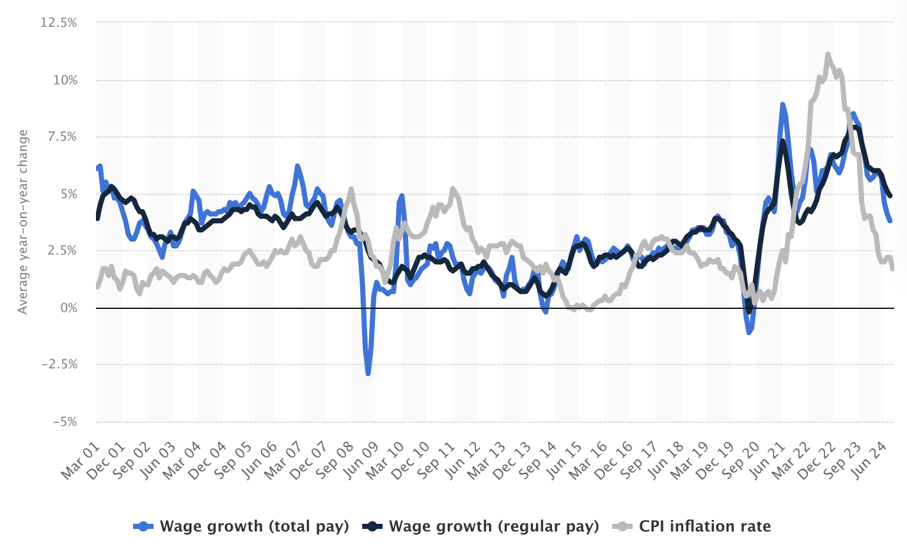

Slide 15
How do these apply to quant?
Trend-based Strategies
Traders may increase exposure to consumer-focused sectors in periods of low unemployment
Inflation Hedging Models
Wage inflation data can be an early indicator of broader inflation
Economic/Business Cycle
Quant professionals often adjust portfolios based on economic cycles; labor market health can signal whether to shift to defensive sectors or growth sectors.

Slide 16
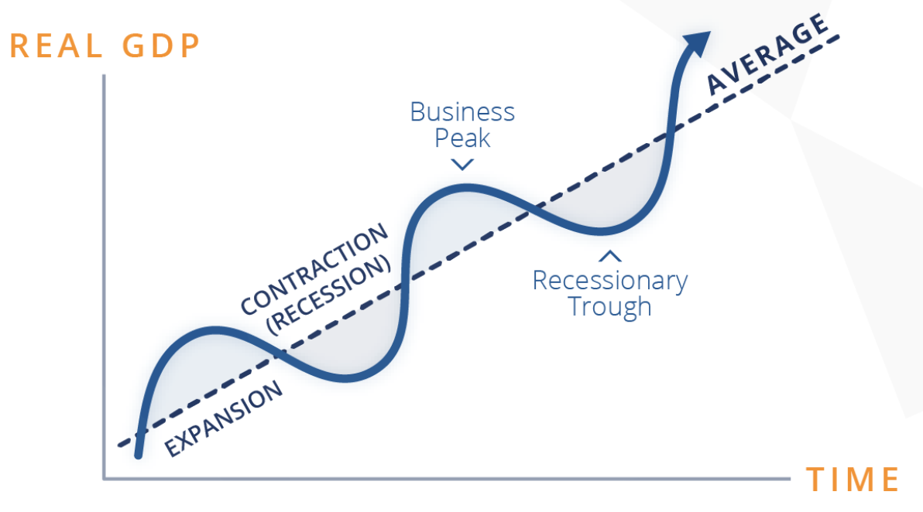
Business Cycle

Slide 17
Real-World Case Study
UK labor market during & post covid-19
High demand in certain sectors (e.g., healthcare, e-commerce, tech)
Labor shortages in others, notably in hospitality, logistics, and retail, due to factors such as Brexit, which impacted the availability of foreign workers.
Wage Inflation: Significant increases in wages were seen as businesses attempted to attract workers back

Slide 18
So,
Given these labor market trends, which sectors would you expect to benefit and which might struggle?
Sectors like healthcare and tech (which faced high demand) could offer stronger returns as they weather wage pressures well.
Labor-intensive sectors (e.g., retail and hospitality) might experience squeezed profit margins, which could affect stock performance.

Slide 19
For Quant People
Rising wage inflation might signal the need to adjust portfolios towards inflation-resistant sectors.
Sectors struggling to fill roles or pay higher wages could see reduced profit margins, signaling potential short opportunities.
Historical labor market data can help create predictive models, giving insight into which sectors or asset classes might perform better under certain labor conditions.

